Slide 1
“Motivating Boys”
“Helping (motivating) boys to be more Christ-like in all areas of life”
Berean Council Workshop
Oct. 1, 2011

Slide 2
Motivating Boys
“Helping boys to be more Christ-like in all areas of life”
Introductions: Your name, your club, what you enjoyed most about your first year as a counsellor

Slide 3
Motivating Boys
“Helping boys to be more Christ-like in all areas of life”
The goal of this workshop is to ask and explore these questions:
What is motivation?
How are boys motivated?
Why do we motivate boys?
How do we keep them motivated?

Slide 4
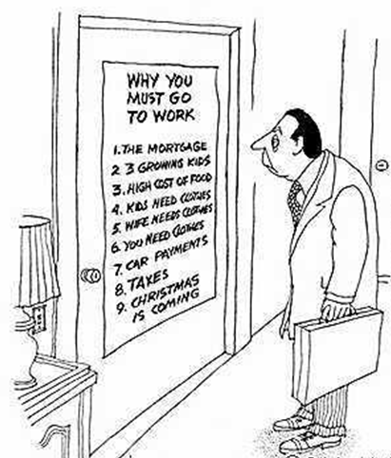
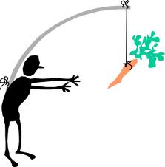
Motivating Boys
“Helping boys to be more Christ-like in all areas of life”
1. What is motivation?

Slide 5
Motivating Boys

Slide 6
Motivating Boys
“Helping boys to be more Christ-like in all areas of life”
2. How Are Boys Motivated?
Motivation (according to this video): the tension that results from an unsatisfied need.
While we are watching the video, listen for…
the ways boys are motivated
why we motivate boys.

Slide 7
Motivating Boys
“Helping boys to be more Christ-like in all areas of life.”
2. How Are Boys Motivated
What ideas for motivating boys did you see in the video?
What ideas for motivating boys can you find in Corps material?

Slide 8
Motivating Boys
“Helping boys to be more Christ-like in all areas of life”
3. Why Do We Motivate Boys?
Why are we trying to motivate the Cadets in our Cadre?
What does the mission of Cadeting say about why we motivate boys?

Slide 9
Motivating Boys
“Helping boys to be more Christ-like in all areas of life”
4. How Do We Keep Boys Motivated
Your turn:
Working in teams of two, come up with at least one new idea for motivating boys. The idea should be consistent with both definitions of motivation. Appoint one person in your team to present your idea.

Slide 10
Motivating Boys
“Helping boys to be more Christ-like in all areas of life”
Recap:
What is motivation?
How are boys motivated?
How do we keep them motivated?

Slide 11
“Motivating Boys”
“Helping boys to be more Christ-like in all areas of life”
Thanks for attending. Please fill out an evaluation if you haven’t done so already. Have a great afternoon!

