Slide 1
Discipline to Discipleship
“Helping (discipling) boys to grow more Christ-like in all areas of life”

Slide 2
Discipline to Discipleship “Discipling boys to grow more Christ-like in all areas of life”
Introductions: Your name, your club, and what you appreciate the most about the Cadet ministry.

Slide 3
Discipline to Discipleship “Discipling boys to grow more Christ-like in all areas of life”
Definitions of Discipline and Discipleship
Experiences
Big Questions
Who are the boys following?
How are we leading?
Practical Steps
Preventing “discipline”
Restorative Justice

Slide 4
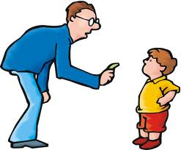
Discipline to Discipleship “Discipling boys to grow more Christ-like in all areas of life”
What is discipline?
Take a few minutes to write down what you think discipline is. Be prepared to share your answers with the group.

Slide 5
Discipline to Discipleship “Discipling boys to grow more Christ-like in all areas of life”
What is discipleship?
Again, take a few moments to write down what discipleship is. Try to come up with Biblical examples as well.

Slide 6
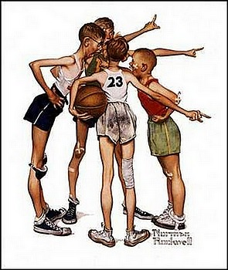
Discipline to Discipleship “Discipling boys to grow more Christ-like in all areas of life”
Experiences
What discipline issues have you had in your Cadet club?
Video
While you are watching, think about 1 or two discipline problems in the video that you can relate to.
Write down some ways that discipline problems can be prevented.

Slide 7
Discipline to Discipleship “Discipling boys to grow more Christ-like in all areas of life”
Big Questions
1. Who are the boys (and men) following?
Let’s make a list of the people/things/ideas that the boys are following.
2. How are we leading? What kinds of things
can we do to become more effective leaders?

Slide 8
Discipline to Discipleship “Discipling boys to grow more Christ-like in all areas of life”
Practical Steps
Prevention: What can we do to prevent discipline problems in our clubs?
Write a few ideas down and let’s discuss them together.

Slide 9
Discipline to Discipleship “Discipling boys to grow more Christ-like in all areas of life”
Practical Steps
2. Restorative Justice
What happened?
How did it happen?
What part did you play in it?
How were you affected/who was affected?
What do you need to make it right?
How can we repair the harm?
Your turn: In groups of 2, you will be doing a role play. Choose one of the problems from our discipline experiences. One person will be the Cadet, the other person will be the Head Counselor. Practice your role play and be prepared to present it to the group.

Slide 10
Discipline to Discipleship “Discipling boys to grow more Christ-like in all areas of life”
Thanks for attending. Please fill out an evaluation form before you go for coffee.

